Slide 1


Slide 2
Benign and Malignant Lesions of the Uterus
Ass. Prof. Dr. Sawsan Talib
Department of Obstetrics and Gynecology
College of medicine/ Diyala University
Lec 3 /5th stage /2021-2022

Slide 3
Endometrium
The uterine endometrium comprises glands and
stroma with a complex architecture, including blood vessels and nerves.
during the follicular phase of the menstrual cycle, proliferation of tissue from the basal layer occurs, followed by secretory changes under the influence of progesterone after ovulation and finally shedding as progesterone levels fall, with corpus luteum regression.

Slide 4
Endometrial Polyps
Localized overgrowths of the endometrial glands and stroma projecting beyond the endometrial surface
Peak age incidence is at 40-49 years
Cause is unknown
but in menapause common in women with HRT and patient take tomoxifen for ca breast.
Mostly are asymptomatic, mostly are detected by sonography.

Slide 5
Common manifestation is inermenstrual bleeding in perimenapaue or postmenapausal bleeding
Has 3 histological components:
    Endometrial glands
    Endometrial stroma
    Central vascular channels

Slide 6
Endometrial Polyps
Malignant transformation is estimated at 0.5%
Differential diagnosis:
    Submucous leiomyoma
    Adenomyoma
    Retained products of conception
    Endometrial hyperplasia
    Endometrial carcinoma
    Uterine sarcoma
Optimal management is removal by Hysteroscopy with D and C

Slide 7
Asherman's syndrome
When the endometrium has been damaged, in particular when it has been removed down to or beyond the basal layer, normal regeneration does not occur, and instead there is fibrosis and adhesion formation.

Slide 8
Asherman's syndrome
causes:
Endometrial resection by using a diathermy loop or is ablated with a laser.
Consequence of excessive curettage, especially for retained placental tissue or miscarriage or secondary postpartum hemorrhage.
tuberculosis and schistosomiasis.

Slide 9
Clinical presentation
Amnnorrahea
Oligomenorrhea
dysmenorrhea
Infertility
Placental pathology in subsequent pregnancy

Slide 10
Diagnosis
. Hysteroscopy
- direct evidence of intrauterine pathology
Hysterosalpingography

Slide 11
management
resection of uterine synechia by D and C or by hystroscope then maintaining separation of the uterine walls by insertion of a large inert IUCD such as
a Lippes loop
Treatment of tuberculosis and
schistosomiasis.

Slide 12
Hematometra
Uterus is distended with blood secondary to gynatresia
Common congenital causes:
    Imperforate hymen
    Transverse vaginal septum
Common acquired causes:
    Senile atrophy of endocervical canal and endometrium
    Scarring of the isthmus by synechiae
    Cervical stenosis associated to surgery, radiation therapy, cryotherapy or electrocautery, endometrial ablation
Malignant disease of endocervical canal .
premalignant disease of the cervix was treated by knife cone biopsy.

Slide 13
Hematometra
Usually suspected by history of amenorrhea and cyclic abdominal pain
Diagnosis confirmed by :
    Ultrasonography
    Probe the cervix with dilator and with release of dark brownish black blood
Management
Depends on the operative relief of lower genital tract obstruction , careful surgical dilatation of the cervix
and endometrial biopsy under antibiotic cover.

Slide 14

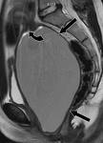
Hematometra

Slide 15
pyometra
In postmenopausal women, cervical stenosis may give rise to pyometra, in which accumulated secretions become a focus of infection. Underlying malignancy may also lead to pyometra.

Slide 16
Leiomyoma (fibroid)
Benign tumors of muscle cell origin
The most frequent pelvic tumor and the most common tumor in women
Highest prevalence above the 3th decade of woman’s life
    Found in 30-50% of perimenopausal women
Symptomatic leiomyomas are the primary indication for approximately 30% of all hysterectomies
Risks factors:
    Increasing age - Early menarche
    Low parity - Tamoxifen use
    Obesity - High fat diet
    positive family history - African racial origin.

Slide 17
a lower risk of fibroids
1-Oral contraceptives
2-Athletic women may have,
3-Pregnancy and giving birth may have a protective effect,

Slide 18
Leiomyoma
3 most common types:
    Intramural
    Subserous
    Submucous
Other types: Intraligamentary and Parasitic myomas
Origin:
    Each tumor develops from a single muscle cell a progenitor myocyte
    Cytogenetic analysis demonstrated that myomas have multiple chromosomal abnormalities affecting regulation of growth-inducing proteins and cytokines

Slide 19
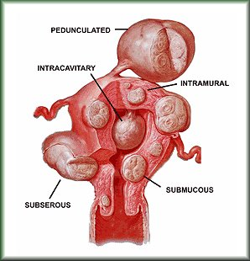
Types of Myoma

Slide 20
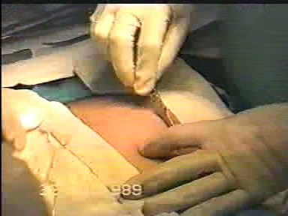
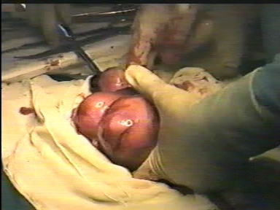
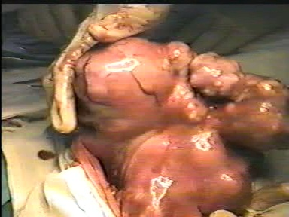
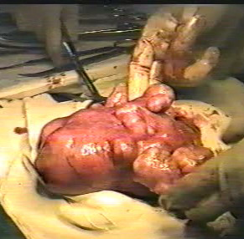
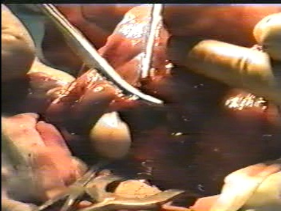
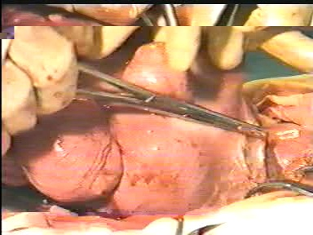
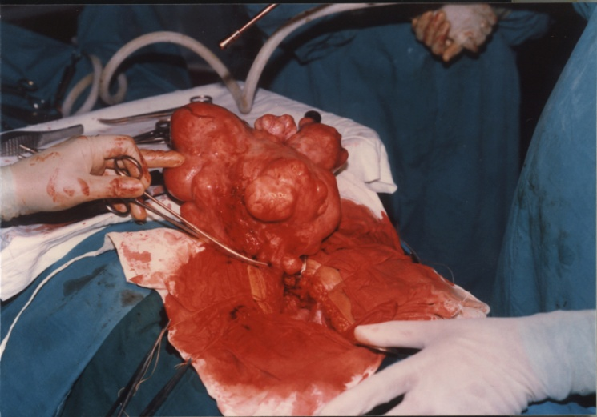
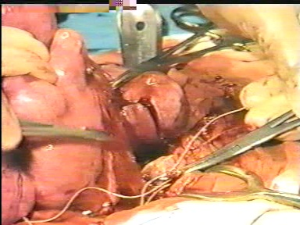
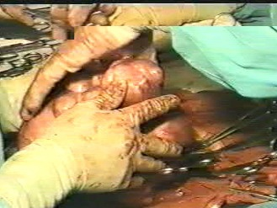
Operation In progress

Slide 21
Leiomyoma
Current theory:
Neoplastic transformation from normal myometrium to leiomyomata is the result of a somatic mutation in the single progenitor cell affecting cytokines that affect cell growth. The growth may be influenced by estrogen and progesterone levels.
Clinical characteristics:
    Rare before menarche, diminish in size after menopause
    Enlarges during pregnancy and occasionally during OCP use
Gross appearance:
    Lighter in color than the normal myometrium
    Cut surface: Glistening, pearl-white with smooth muscle arranged in trabeculated or whorl configuration.

Slide 22
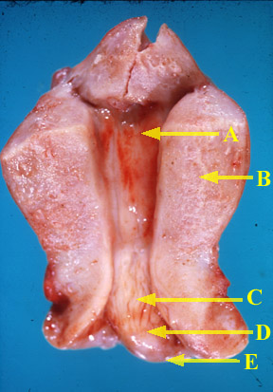
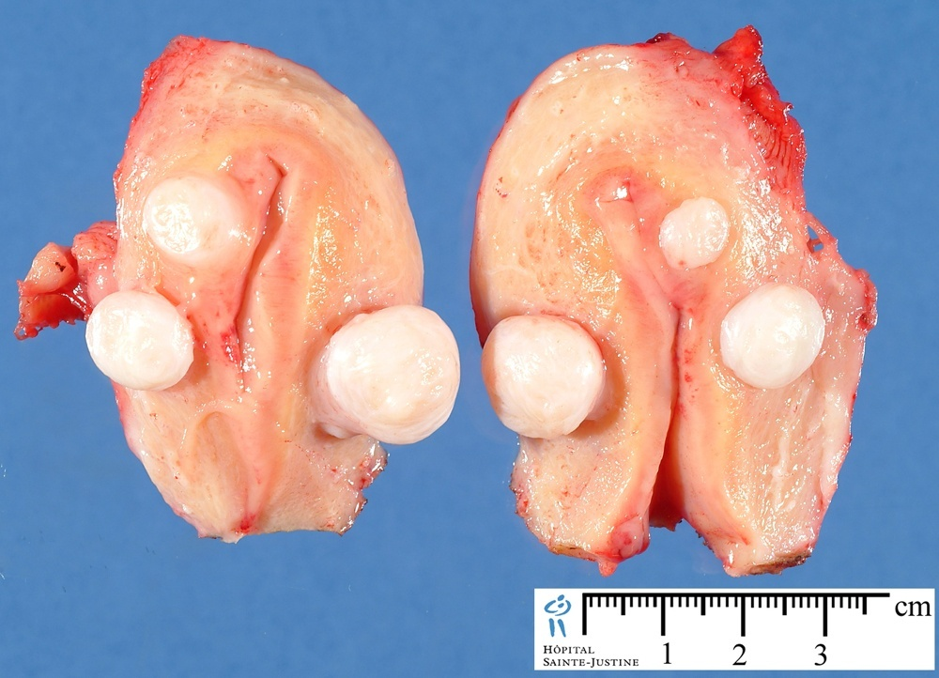
Leiomyoma

Slide 23
Leiomyoma
Histologic appearance:
With proliferation of mature smooth muscle cells. The nonstraited muscle fibers are arranged in interlacing bundles with variable amount of fibrous connective tissue in-between.
Types degeneration:
    Hyaline - Myxomatous
    Calcific - Cystic
    Fatty - Necrosis
    Red or Carneous

Slide 24
Red degeneration follows an acute disruption of the blood supply to the fibroid during active growth, classically during pregnancy. This may present with the sudden
onset of pain and tenderness localized to an area of the uterus, associated with a mild pyrexia and leukocytosis. The symptoms and signs typically resolve over a
few days and surgical intervention is rarely required.
Hyaline degeneration occurs when the fibroid more gradually outgrows its blood supply, and may progress to central necrosis, leaving cystic spaces at
the centre, termed cystic degeneration.
As the final stage in the natural history, calcification of a fibroid may be detected incidentally on an abdominal X-ray in a postmenopausal woman. Rarely, malignant or
sarcomatous degeneration has been occur.

Slide 25
Leiomyoma
Malignant transformation is 0.3 to 0.7%, usually into a Sarcoma.
Clinical Manifestations:
The great majority do not cause symptoms but may be identified coincidentally, for example at the time of taking a cervical smear or performing laparoscopic sterilization.
    Most common symptom:
    Pressure from an enlarging mass
    Pain including dysmenorrhea and red degenration during pregnancy or twisted subsrosal type.
    Abnormal uterine bleeding(menorraghea).
    Sub fertility
    Recurrent pregnancy lose
    Malpresentation and postpartum hemorrhage

Slide 26
Symptoms (infrequently)
  Rectosignoid compression with constipation or intestinal obstruction
  Prolapse of a pedunculated submucous tumor through the cervix
  → severe cramping and subsequent ulceration and
  infection (uterine inversion has also been reported)
  Venous stasis of lower extremities and possible thrombophlebitis 2nd to pelvic compression
  Polycythemia
  Ascites
  Rapid growth after menopause, consider Leiomyosarcoma

Slide 27
Fibroid location influences signs and symptoms
Submucosal fibroids. Fibroids that grow into the inner cavity of the uterus it is responsible for prolonged, heavy menstrual bleeding & dysmenghroea.
Subserosal fibroids. Fibroids project to the outside of the uterus press on bladder, causing urinary symptoms.
If fibroids bulge from the back of uterus, they occasionally can press on rectum, causing constipation on spinal nerves, causing backache.

Slide 28
Complications of fibroids
1-Degenerations;Hylain ,necrosis, red degeneration ( pregnancy, menopause) ,calcifications .
2-Sarcomatous changes;<0.05%
3-Infection
4-Rare:
a-Parasitic attachment to omentum bowel to gain blood supply,
b- metastasis through blood vessels to vessel wall,
c-Polycythmia associated with broad ligament fibroid

Slide 29
Effect of pregnancy on fibroid
Subinvolution
Ascending infection
Torsion

Slide 30
Effects of Fibroid on Pregnancy
1-Infertility
2-Abortion
3-PUC
4- preterm labor
5-Abruptio placentae
6-abnormal Lie & position
7-Increase rate of operative delivery
8-PPH (uterine atony) .

Slide 31
Leiomyoma
Diagnosis:
    Physical examination – Internal examination
        Palpation of an enlarged, firm, irregular uterus
    Ultrasonography
    Hysteroscopy
    hystrosalpingiography
    CT Scan or MRI
Differential diagnosis:
    Pregnancy
    Adenomyosis
    Ovarian neoplasm

Slide 32
TREATMENT
There's no single best approach to uterine fibroid treatment

Slide 33
Management:
  Observation – for small and asymptomatic
  Operative:
    Myomectomy
    Hysterectomy
  Medical:
    GnRH agonists - Danazol
    Medroxyprogesterone acetate - RU 486
  Uterine artery embolization
    - Gelatin sponge (Gelfoam) silicon spheres - Metal coils
    - Polyvinyl alcohol (PVA) particles - Gelatin microspheres

Slide 34
Conservative management is appropriate where
asymptomatic fibroids are detected incidentally. It may
be useful to establish the growth rate of the fibroids by
repeat clinical examination or ultrasound after a 6-12-
month interval.

Slide 35
Factors affecting the type of surgical approach:
      Age of the patient
      Parity
      Future reproductive plans
Classic indications for Myomectomy:
      Persistent abnormal bleeding
      Pain or pressure
      Enlargement of an asymptomatic myoma to more than 8 cm in a woman who has not completed chilbearing

Slide 36
Leiomyoma
Contraindications to Myomectomy:
    Pregnancy
    Advanced adnexal disease
    Malignancy
    When enucleation of the myoma results in severe reduction of endometrial surface that the uterus would not be functional
Myomectomy maybe performed through:
    Laparoscopy
    Hysteroscopy
    Laparotomy
    Vaginally

Slide 37
Leiomyoma
Indications for Hysterectomy:
  All indications for myomectomy,
  plus:
  Asymptomatic myomas when the uterus that has reached the size of 14-16 weeks gestation
  Rapid growth of myoma after menopause

Slide 38
Medical treatment
practical currently available medical treatment is ovarian
suppression using a gonadotrophin-releasing hormone
(GnRH) agonist. Unfortunately, very effective in shrinking fibroids, when ovarian function returns, the fibroids regrow to their previous dimensions.
Mifepristone (an antiprogestogen) has been shown to be effective in shrinking fibroids at a low dose, but is not available for use in this indication.
The optimal dose, duration of treatment and long-term effects have yet to be established.

Slide 39
Advantages of Preoperative GnRH Agonist Treatment:
Advantages Gained by Uterine-Fibroid Shrinkage
    May allow vaginal hysterectomy
    May decrease intra-operative blood loss
    May allow Pfannenstiel incision
    May facilitate endoscopic myomectomy
Advantages Gained by Induction of Amenorrhea
    May correct hypermenorrhea-menorrhagia-associated anemia
    May improve ability to donate blood
    May decrease need for non-autologous blood transfusion
    May atrophy endometrium, facilitating hysteroscopic resection of submucosal myoma

Slide 40
Disadvantages of Preoperative GnRH Agonist Treatment:
  Delay to final tissue diagnosis
  Degeneration of some myomas, necessitating piecemeal enucleation at myomectomy
  Hypoestrogenic side effects.
      Trabecular bone loss
      Vasomotor symptoms: e.g. hot flushes
  Cost
  Need to self-administer or receive injections in many cases
  Vaginal hemorrhage in approximately 2% of patients

Slide 41
New developments
Endoscopic surgical treatments for fibroids have proved
Disappointing.
myolysis using a diathermy needle to destroy the tissue is followed by intense adhesion formation.
interruption of the arterial supply to the tumour is atheoretically attractive concept. In practice, this is feasible by the radiological technique of percutaneous selective catheterization of the uterine arteries. Microparticles are released into the vessel s, causing occlusion of both uterine arteries.

Slide 42
Complications of Uterine Artey Embolization:
  Post-embolization fever
  Sepsis from infarction of the necrotic myometrium
  Ovarian failure
  Abdominal pain

Slide 43
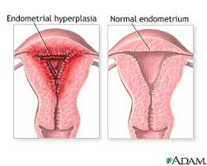
ENDOMETRIAL HYPERPLASIA

Slide 44
ENDOMETRIAL HYPERPLASIA
Endometrial premalignant conditions are less easily diagnosed and followed up.
Any hyperplastic condition raises the question of development of cancer and assessment of risk is important.
Hyperplasia and carcinoma may coexist.
Endometrial hyperplasia may be classified as simple, complex or atypical.
Heavy and/or irregular vaginal bleeding are the presenting symptoms but its severity or frequency is not related to the degree of pathological change.

Slide 46
SIMPLE HYPERPLASIA
This is the most common type. The endometrium has a characteristic appearance, often termed ‘Swiss cheese’ or cystic glandular hyperplasia.
At low power magnification the pattern is a mixture of glands of varying sizes,
a significant proportion of them being cystic.
There is no crowding of the glands which are lined by cubical
or columnar epithelium.
Mitotic figures are present in small numbers.

Slide 47
COMPLEX HYPERPLASIA
In this grade of hyperplasia the most striking feature is the quite obvious hyperplasia –
crowding of glands so that they are back-to-back,
the epithelium is stratified
mitoses are relatively frequent.
There is, however, no epithelial atypia.
ATYPICAL HYPERPLASIA
At this stage nuclear atypia is present.
Intraglandular polypoid formations
abnormal mitotic figures are seen.
Severe cases may be indistinguishable from a carcinoma and adjacent areas of endometrial carcinoma may occur.

Slide 48
INVESTIGATION
Ultrasound
endometrial biopsy, with or without hysteroscopic assessment
Investigation will usually be in an outpatient setting but inpatient general anaesthetic assessment may also be needed.
TREATMENT
This depends principally on
The types of hyperplasia.
The age of the patient and
A desire to retain fertility are factors to be considered.

Slide 49
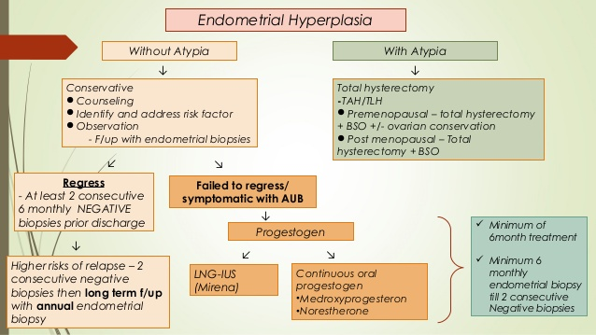
TREATMENT

Slide 50
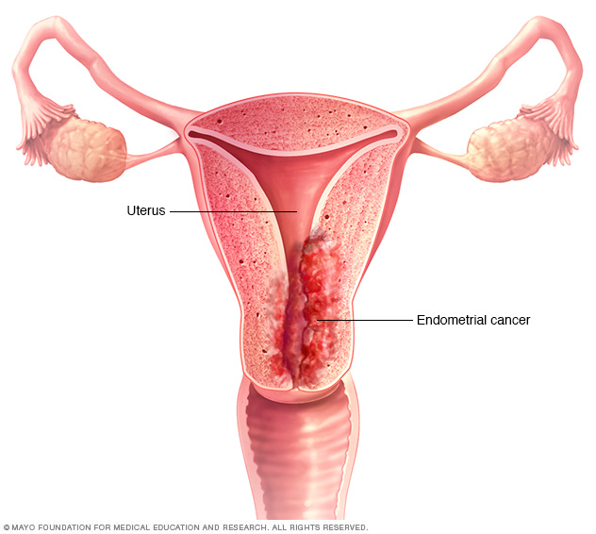
CARCINOMA OF THE ENDOMETRIUM

Slide 51
CARCINOMA OF THE ENDOMETRIUM
One of the commonest gynaecological cancers
it occurs most often in postmenopausal women (up to 80% of cases)
less than 5% diagnosed under 40 years of age
There is no effective screening programm, but postmenopausal bleeding may be a cardinal symptom prompting urgent investigation.

Slide 53
PRESENTATION OF ENDOMETRIAL CA
Abnormal vaginal bleeding  most common 90%
Premenopausal Pt  usually c/o heavy flow at the time of menses
may present with
 persistent intermenstrual bleeding
 pre or post menstrual spotting
 polymenorrhea that fails to respond to hormonal Rx
Postmenopausal bleeding is the most common type of abnormal bleeding  12-15% due to E Ca
 5-8% due to other cancers like uterine sarcoma, ovarian Ca, Cx, tubal or vaginal Ca
Postmenopausal Pt  commonly c/o intermittent spotting
Postmenopausal vaginal discharge 10%

Slide 54
Asymptomatic women with glandular abnormalities on routine PAP smear/ abnormalities found in 50% of Pt with E Ca
Advanced disease  symptoms due to local or distant metastases
Sever cramps due to hematometra or pyometra  occur in postmenopausal Pt with Cx stenosis ----10%
At times, there is watery and offensive discharge due to pyometra.
Pain is not uncommon. It may be colicky due to uterine contractions in an attempt to expel the polypoidal growth.
Few patients (< 5%) remain asymptomatic.

Slide 55
Signs:
The patient presents with varying degrees of pallor.
Pelvic examination:
Speculum examination reveals the cervix looking healthy and the blood or purulent offensive discharge escapes out of the external os.
Bimanual examination reveals—The uterus is either atrophic, normal or may be enlarged due to spread of the tumor, associated fibroid or pyometra. The uterus is usually mobile unless in late stage, when it becomes fixed.
Rectal examination corroborates the bimanual findings. Regional lymph nodes and breasts are examined carefully.

Slide 56
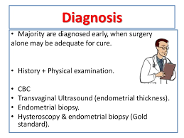

Slide 57
Where the endometrial thickness is measured to be less than 3 mm in women not on HRT
and less than 5 mm in women taking HRT, there is an extremely low incidence of endometrial cancer and the patient can be reassured.
In addition, careful inspection of the cervix, vulva and vagina should be undertaken to exclude these as a source of bleeding due to malignant change
MRI is preferable to an US for the assessment of myometrial invasion and pelvic spread.
To assess distal metastases (CT) scan of the chest, abdomen and pelvis may also be of value.

Slide 58
HISTOLOGY
Distribution of Subtypes
Endometrioid 85%
Adenosquamous 4%
Serous carcinoma 4%
Clear cell 3%
The majority of tumours are adenocarcinoma and they are divided into three groups according to the degree of glandular differentiation.
Grade 1 – Well differentiated
Grade 2 – Moderately differentiated
Grade 3 – Poorly differentiated. This type consists of solid masses of malignant cells of varying sizes and shapes with little or no stroma. Mitoses are numerous.

Slide 59
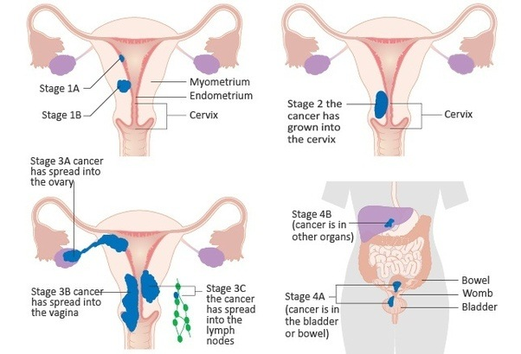
Stages of endometrial carcinoma

Slide 60
SPREAD OF ENDOMETRIAL CARCINOMA
LOCAL SPREAD:
Invasion of the myometrium and cervix is the commonest spread. It may produce considerable uterine enlargement.
LYMPHATIC SPREAD
Lymphatic spread is more likely to occur when the tumour is poorly differentiated and the uterine wall is deeply invaded.
The incidence of pelvic nodal metastases is in the region of 10%.
Most metastases occur in the adjacent structures and in the peritoneum.
In advanced cases, distant metastases do occur, most commonly in lung, but occasionally in liver, vertebrae or other bones and in the supraclavicular lymph nodes.

Slide 62
AETIOLOGICAL FACTORS IN ENDOMETRIAL CARCINOMA
There are two suggested types of endometrial carcinoma, based on etiology.
Type 1 – arising in patients with a background history of estrogen excess (have a better prognosis, better differentiation pattern, less invasive component)
Type 2 – arising without evidence of estrogenic stimulation (including serous and clear cell cancers, arise from a atrophic type endometrium, aggressive phenotype with greater invasion, poorer differentiation, more metastatic disease, they carry a poorer prognosis )
Hereditary non-polyposis colorectal cancer (Lynch II) syndrome is an inherited mutation in DNA mismatch repair genes. In those affected, the endometrial carcinoma occurs more frequently, together with breast and colon cancer.

Slide 63
PROGNOSIS OF ENDOMETRIAL CARCINOMA
The survival is affected by multiple prognostic factors including:
Stage at diagnosis
Histological grade
Depth of myometrial invasion
Lympho-vascular space involvement (LVSI)
Non-endometrioid type

Slide 65
In stage I , surgery is the mainstay of treatment
TAH & BSO ( uterus is opened at operating room for evaluation of size, extention and and myometrial invation)
Lymph node sampling of the following areas is done : (i) Common iliac (ii) External iliac (iii) Internal iliac (iv) Obturator and (v) Paraaortic.
IN STAGE 2 CARCINOMA
Management options are:
A. Radical hysterectomy BSO with pelvic and para-aortic lymphadenectomy.
B. Combined radiation and surgery: Radiation (external and intracavitary) followed in 6 weeks by TAH and BSO. or
C. Initial surgery (modified radical hysterectomy) followed by external and intravaginal radiation

Slide 66
STAGE III/IV
Treatment of this stage is designed to control tumour growth and alleviate symptoms.
Treatment will depend upon tumour burden at the preoperative assessment and imaging.
Many cases may only be identified as Stage III, following surgical management.
Surgery, radiation therapy, chemotherapy and adjuvant progestogen therapy all have a place.

Slide 67
SARCOMA OF THE UTERUS
These are rare tumours and include:
Endometrial stromal sarcomas
Leiomyosarcomas
Carcinosarcomas
CLINICAL FEATURES
The patient is usually over 50 years old
Presents with a complaint of fairly heavy bleeding of recent origin Accompanied by pain.
Pelvic examination reveals a large intrauterine mass with friable tissue palpable through the os.
The tumour may originate from the vagina in younger women and from the cervix in the child; but these are, indeed, very rare conditions.
Sarcomatous change may occur in 0.1% of fibroids.

Slide 68
Tumour tissue may infiltrate the whole myometrium and fill the uterine cavity or arise from a pedicle.
This type often presents as a cervical or vaginal polyp.
The tissues of origin are the connective tissue and muscle of the myometrium or leiomyoma, or the endometrial stroma.

Slide 69
ENDOMETRIAL STROMAL SARCOMAS
These are tumours of the endometrial stromal cells and form two groups:
Low Grade Stromal Sarcomas
The clinical course is often uncomplicated and cure may follow surgery. They can recur, often years later, and recurrence up to 25 years later has been reported.
High Grade Stromal Sarcoma
This type of stromal tumour shows numerous mitoses and is infiltrative from the start.
There is early recurrence and widespread metastases occur even if there has been little local invasion of the myometrium. The prognosis is poor.

Slide 70
CARCINOSARCOMA (MALIGNANT MIXED MESODERMAL TUMOUR)
In this variant, both epithelial and stromal elements are malignant.
It forms a soft polypoid mass that is usually haemorrhagic.
Microscopically, most of the growth is sarcomatous but there are foci of carcinoma – adeno, squamoid, undifferentiated or various mixtures of these.
The prognosis is poor.
Treatment is surgical with hysterectomy, bilateral salpingooophorectomy and pelvic lymphadenectomy

Slide 71
LEIOMYOSARCOMA
Usually these cases do not present with postmenopausal bleeding and are found in patients thought to have a uterine fibroid.
Fibroids of a very large size or those which increase rapidly in size should be suspected as having a higher chance of malignant change.
Treatment is usually hysterectomy and bilateral salpingo-oophorectomy.
It is often not suspected at diagnosis. If detected postoperatively, then CT scan of chest, abdomen and pelvis should be undertaken to look for metastases.
10% of cases at diagnosis may have pulmonary metastases. Haematogenous spread is most common

Slide 72


